Slide 1
Energy Support in Gloucestershire

Slide 2
Who we are
Severn Wye Energy is a registered charity founded in 1999. Working across the Welsh borders, Herefordshire, Gloucestershire and South Gloucestershire.
We deliver practical change in tackling and overcoming fuel poverty, energy efficiency of homes, acting on climate change and working towards sustainable communities.
Community-based Energy Advisers- Offering home visits and telephone consultations.

Slide 3
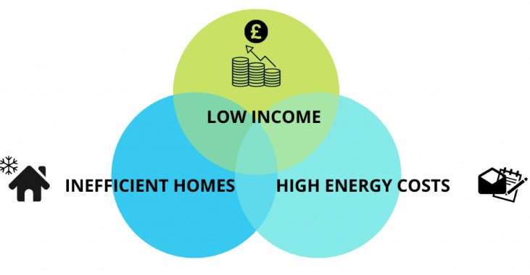
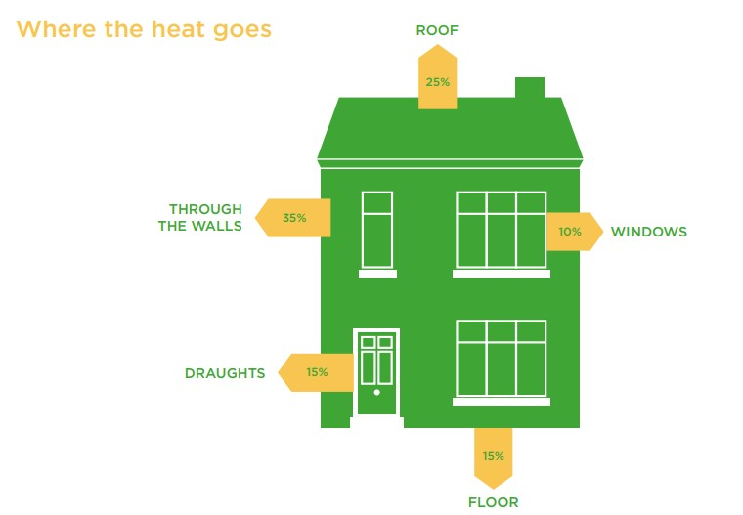
Fuel Poverty explained
Fuel Poor: Unable to afford to warm your home to maintain good health
Underheated property=condensation & mould, exacerbates poor health or further ill-health
Further higher costs for households off gas e.g. electricity only and night storage heaters.

Slide 4
How do we find those that need help?
Organisations refer to: www.severnwye.org.uk/refer
Drop ins
Events
Talks
Adviceline
Marketing & communications
Word of mouth
Social Media

Slide 5
Energy Advice
Heating systems and settings checked e.g. Boiler and hot water tanks, room thermostats and thermostatic radiator valves, Night Storage Heaters, High Heat Retention Heaters and Air Source Heat Pumps (ASHP).
Type of meter/s: Credit mode meter-Smart 1 and Smart 2 or traditional, pre-payment meter/smart pay as you go. More about smart meters on next slide!
Ways of paying for energy i.e. on bill/direct debit, pay as you go.
Regular meter readings for accurate billing. Benefits of Smart Meters with In-Home Displays. This includes accessible meters for those with additional needs.
Checking bills (statements), tariff-variable/fixed, meter serial numbers, whether meters are correct or faulty.
Explaining billing. Examples-Standing daily charge (SDC), price per unit of energy (Kilowatt hours-KWH) and estimated annual usage.

Slide 6
Priority Service’s Register
Who can join.
Pensionable Age
Living with children 5
Someone chronically ill
Someone disabled living at the property
Use medical equipment
English is not their first language and needs documents translated into another language
Temporarily need extra support
Under 18 householders
Benefits of joining.
Alternative heating and cooking appliances if the gas supply is interrupted
Their own password to make sure they know the engineers are genuine
Supplier may be able to move the meter if you cannot access it
Knock and wait- the engineers will allow extra time for the door to be answered
Ask supplier to send the bill to someone who agrees to receive it

Slide 7
Signs and symptoms of CO
Gas appliances that are burning with a floppy yellow or orange flame
Extra condensation inside windows
Pilot lights on boilers frequently blowing out
Soot or yellow stains around appliances
Can be similar to food poisoning or the flu however does not cause a high temperature
Headache
Dizziness
Nausea
Tiredness and confusion
Stomach pain
Shortness of breath and difficulty breathing

Slide 8
How to prevent CO
Get an audible CO alarm and make sure it’s in the correct position
Test your CO alarm regularly
Check that your CO alarm is certified to British Standard BS EN 50292:2023
Get your gas appliances serviced annually by a Gas Safe Registered Engineer

Slide 9
Locking Cooker Valves
Allows the gas supply to be turned on and off easily. It can prevent accidents such as gas cookers being left on unintentionally but does not affect the boiler.
Carers can turn the valve on and off by simply using a key so the cooker can be operated under supervision
People can be referred using the LCV section of the Wales and West online form or by making a referral on their website

Slide 10
Smart meters-benefits
Accurate billing, no need to give readings unless a signal error occurs. Access to supplier discounts e.g. time in use tariffs and rewards. Supports clients with vulnerabilities making life easier for them. Accessible in-home display too.
In-home Display uses radio waves i.e. wireless system. Less risks than wired systems * Government Dept for Health. Same as using your TV on standby or your car key. ☺ Cost £2 a year to run 24/7.
Snoozes at 10pm, wakes at 7am! Applies your standing daily charges at midnight.
Second Generation rolled out in 2018. Across the Smart Network so you can change suppliers ☺ Generation 1 being moved and adopting smart network over time. We can ask for you to be moved!
Smart meters and the in-home display supports you with reducing your energy use. Seeing and understanding how you use your energy means lower bills and a lower carbon footprint. Win/Win.
Notes:
No need to trek out to take readings when dark, cold wet and windy.
Helpful for those living with VI and mobility difficulties.
Wired systems most of us use without a glance!
We accept meter reading off meters without hesitation-generally.
Any doubt with meter readings that’s where we can support and ensure meters are reading correctly.
We could all do with snoozing at 10pm and waking at 7am! Well I could!

Slide 11
Energy Efficiency Advice What households can do
Lower the room thermostat temperatures, lower thermostatic radiator valve settings to 3-4.
Draughtproofing. Ventilation equally important.
Try not to leave appliances on standby.
Use our top ten and 101 tips advice.
Call our Adviceline for further grants to improve your home
Check what tariff they're on
Notes:
Adopt behavioural changes improving energy use. Age UK link to finding out whether clients have a smart meter (confirms SMET 1 or 2)
https://smartmetercheck.citizensadvice.org.uk/meters
MPAN needed and postcode. This can be found by searching my supplier at National Grid for electricity National Grid - Who is my electricity supplier? and Gas Find My Supplier

Slide 12
Liaising with Energy Suppliers and Fuel Debt Support
Setting up account.
Meter and tariff changes.
Any issues with their energy and supplier.
Repayment Plans where struggling with energy debt.
Support with budget plans for your energy supplier, advocating for breathing space and trust fund applications to reduce/clear debt.
Support with complaints directly with suppliers and Ombudsman

Slide 13
Further Support
Provide small measures :
Top 10 and 101 Tips Advice.
Thermocards and low energy lightbulbs.
Draughtproofing (doors/sash windows) and chimney sheep's.
Reflective radiator panels.
Electric throws and Electric oil filled radiators in a no heat situation.
Care bags during winter. Low cost repairs e.g. thermostats and central heating controls.
All measures subject to availability.
PDF Energy guides at Resources - energy efficiency at home – Severn Wye

Slide 14
Grants and Funding-Larger Measures
Measures depend on meeting eligibility criteria and grant/funding availability.
Various funding and grants to improve the energy efficiency of your home, reduce your bills and help reduce your carbon footprint.
Gloucestershire and South Gloucestershire households:
Call Adviceline 0800 500 3076 or go to https://warmandwell.co.uk/grants-and-funding/https://warmandwell.co.uk/grants-and-funding/
Herefordshire households call Adviceline 0800 170 1432
**Under current government legislation landlords are not expected to contribute more than £3500 towards improvement measures. https://www.gov.uk/guidance/domestic-private-rented-property-minimum-energy-efficiency-standard-landlord-guidance
Notes:
Some current measures as of June 2024:
Insulation, usually cavity walls and lofts, loft top ups and floors.
Repair scheme for boilers/heating system , broken/cracked oil tanks, replace broken down central heating radiators, storage heaters, hot water tanks and immersion heaters, central heating controls and additional radiators.
Cleaner heating systems such as air source heat pumps and high heat retention storage heaters.
Thermostatic radiator valves on traditional gas central heating as well as smart heating controls.
Minimum Energy Efficiency Standards (MEES) https://www.gov.uk/guidance/domestic-private-rented-property-minimum-energy-efficiency-standard-landlord-guidance

Slide 15
Continuous Professional Development (CPD)Training
Introduction to Energy Use in the Home and Fuel Poverty Awareness
Training to help you identify communities and households who may be at risk of fuel poverty.
Fully certified by CPD Certification Service (count towards CPD goals). Aimed at organisations/services supporting communities and households.
2 hours 15 mins online with Zoom. To book your place go to:
warmandwell.co.uk/events for Gloucestershire and South Gloucestershire
severnwye.org.uk/events for Herefordshire

Slide 16
Signposting/Referrals
Safe and Well checks-Gloucestershire Fire Service.
Food Pantries.
Recognised Debt Charities if more than energy debt.
Severn Trent Water and the Big Difference Scheme.
Social Tariffs-Broadband, TV packages and mobile providers.
Partner referrals such as Housing, Age UK, Homeshare, Digital Inclusion, Job Clubs and many more!

Slide 17
Referral link and contact
Referral link www.severnwye.org.uk/refer
Email communityadvice@severnwye.org.uk
Phone 0800 170 1432

